Slide 1

HOSPITABILITY ANALYSIS
Group 1

Slide 2
Summary
Hospitality refers to extending a welcome to guests or offering a home away from home.
Key Aspects: Accommodation, Food, & Beverages, Travel & Tourism, Entertainment & Recreation.
Importance of Hospitality:
Customer Experience
Economic Impact
Challenges in Hospitality:
Maintaining high standards.
Adapting Trends
Economic fluctuations
Hospitality is an integral part of the service industry, dedicated to ensuring that guests feel welcomed, comfortable, and valued. It plays a crucial role in driving economic activity, promoting cultural exchange, and enhancing the overall travel and leisure experience.

Slide 3
KPIs Used
Total Revenue
Occupancy
Cancellation Rate
Total Booking
Utilize capacity
Trend Analysis
Weekday & Weekend Revenue and Booking
Revenue by State & hotel
Class Wise Revenue
Checked out cancel No show
Weekly trend Key trend (Revenue, Total booking, Occupancy)

Slide 4

EXCEL DASHBOARD

Slide 5
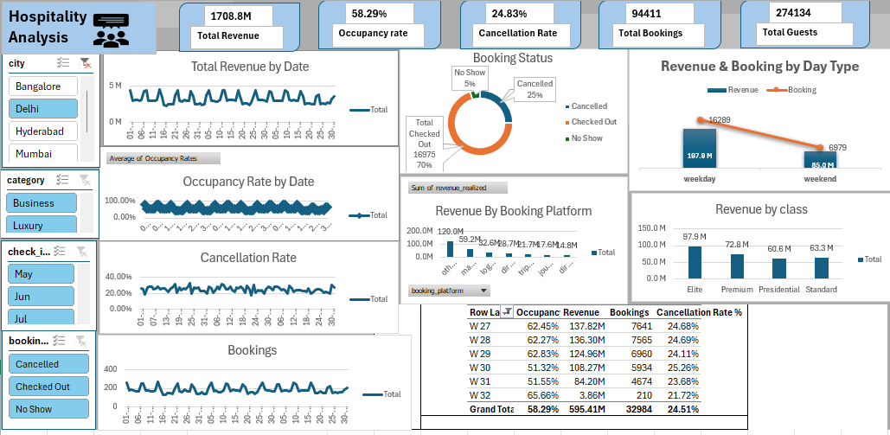

Slide 6

POWER BI DASHBOARD

Slide 7
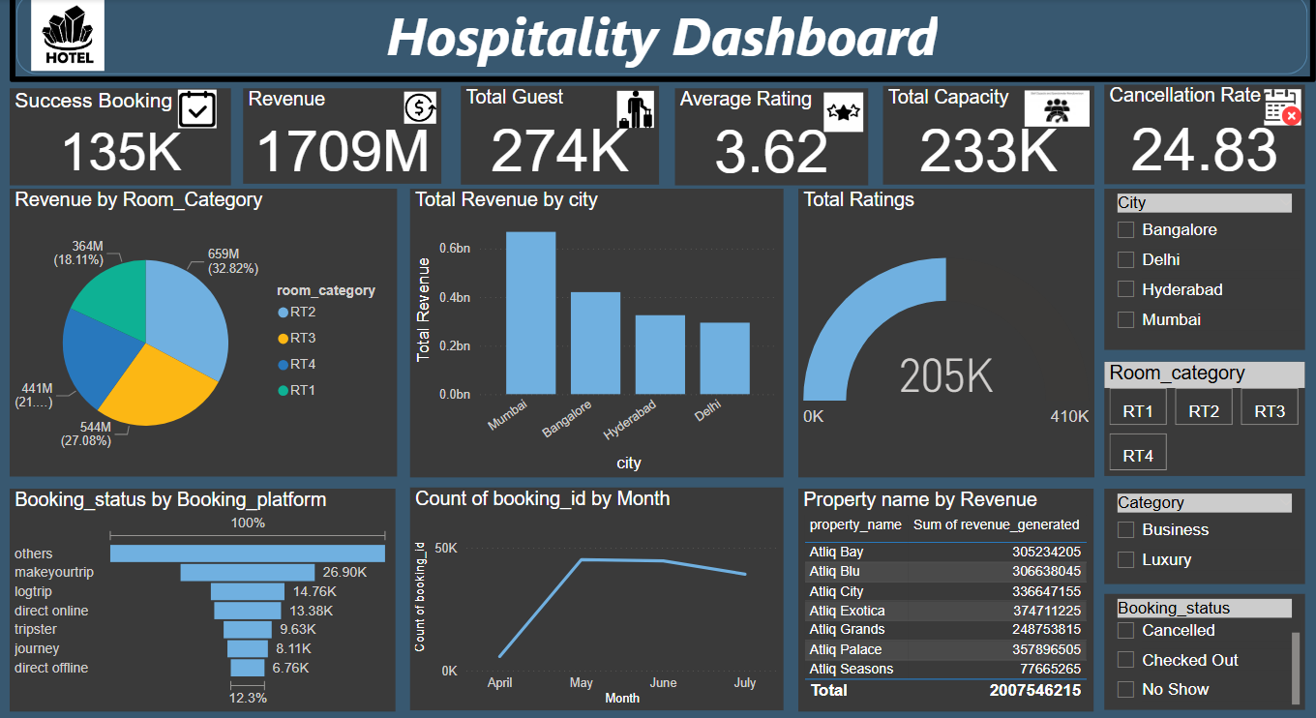

Slide 8

TABLEAU DASHBOARD

Slide 9
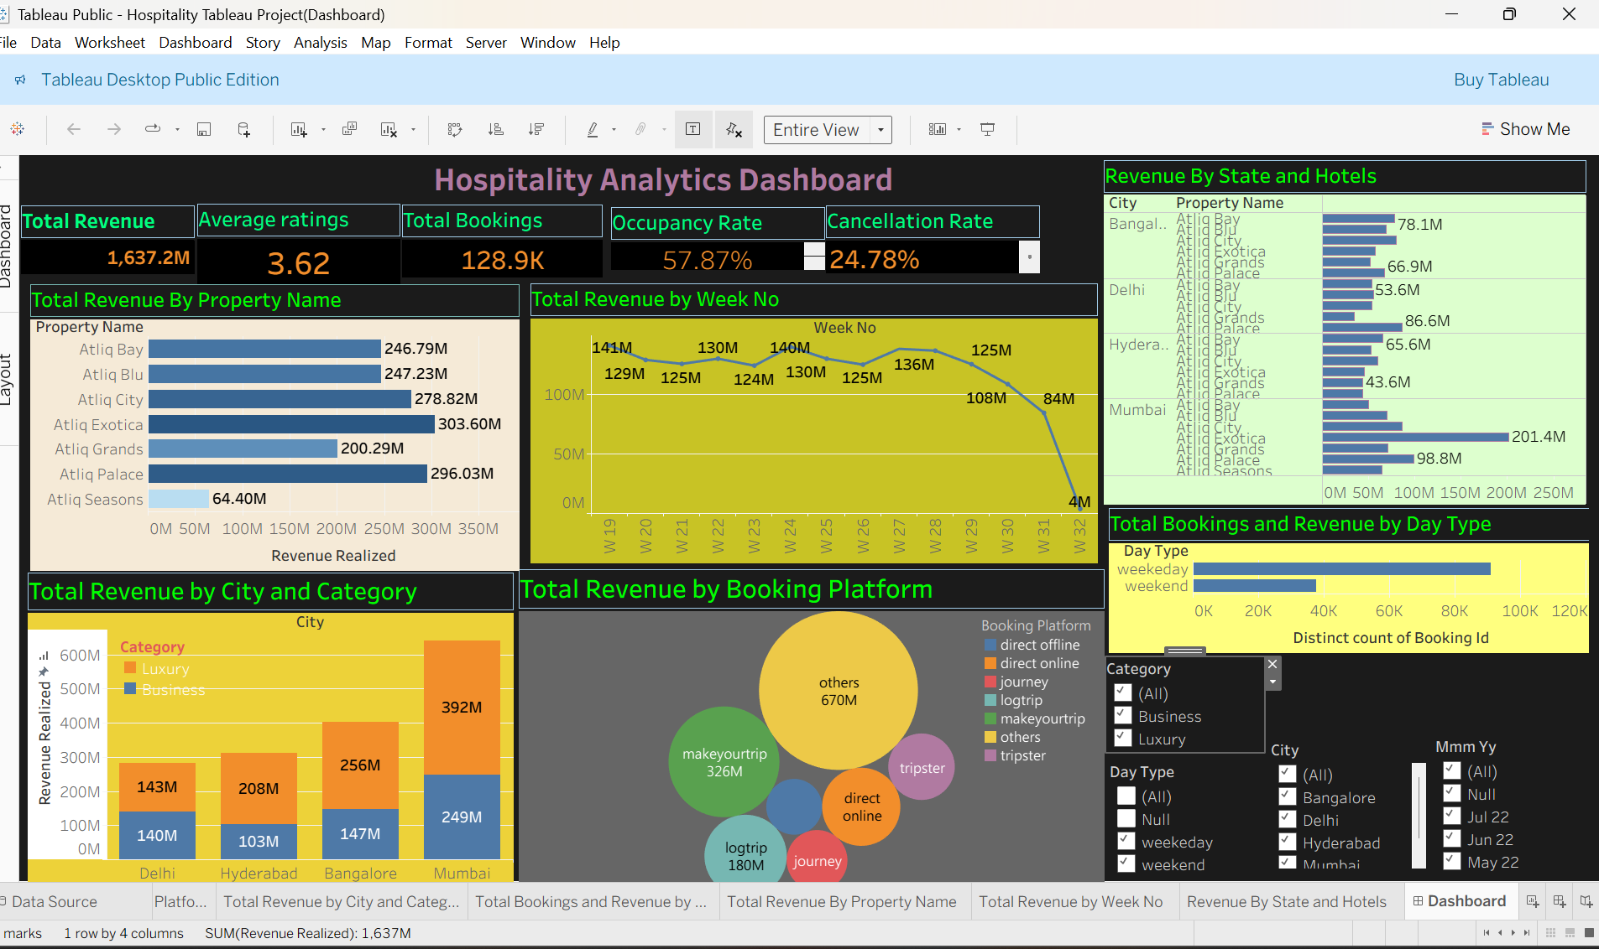

Slide 10

SQL QUERIES

Slide 11
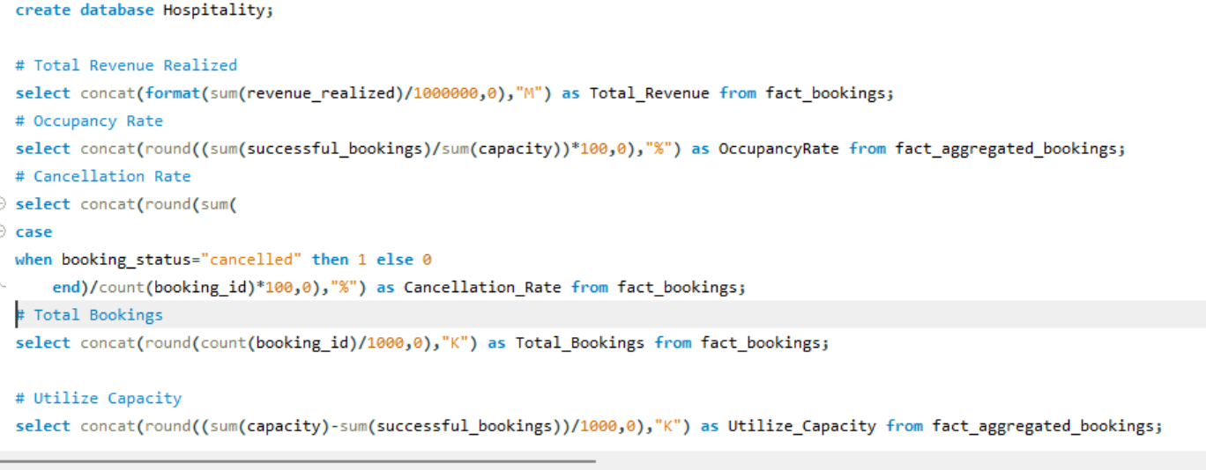

Slide 12
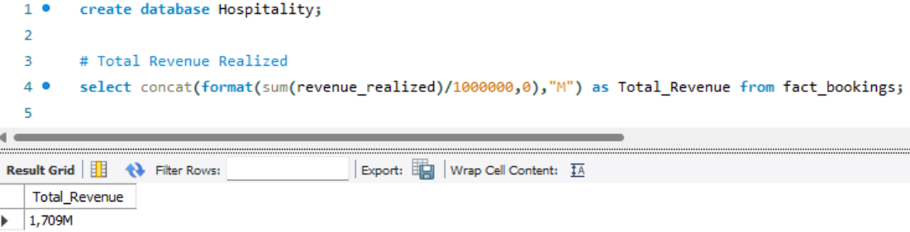
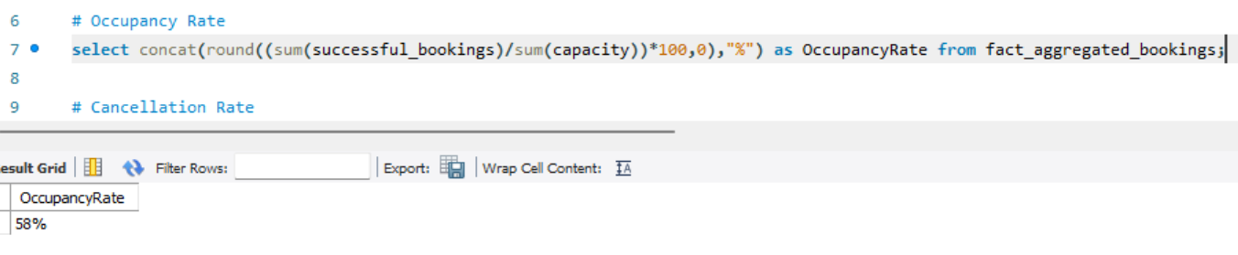
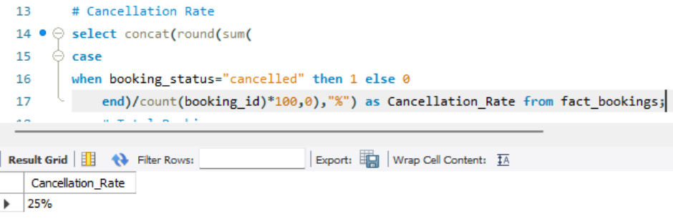

Slide 13
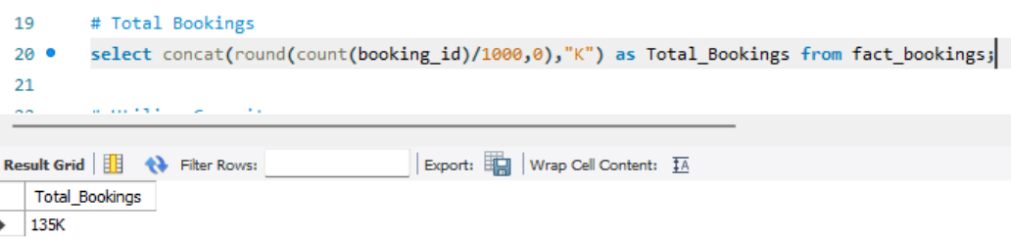
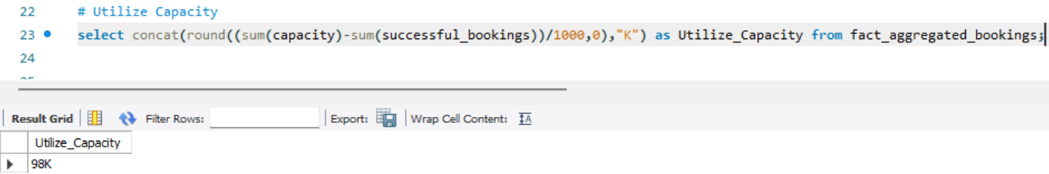
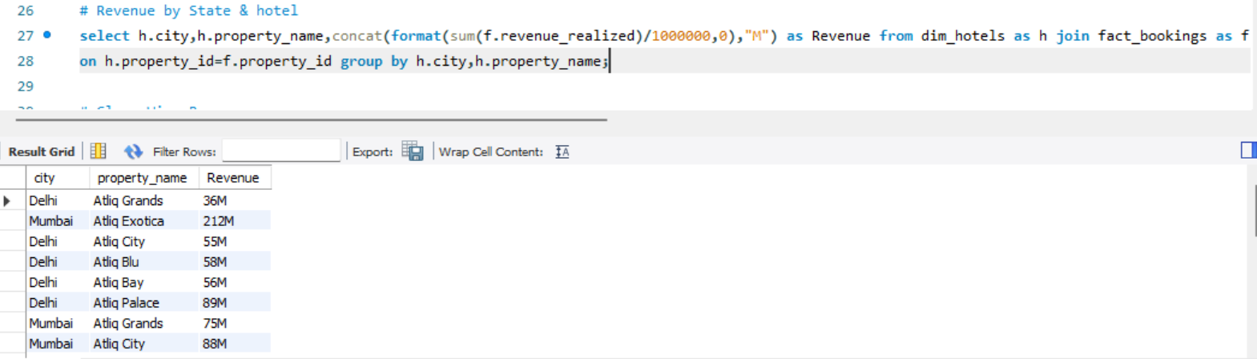

Slide 14
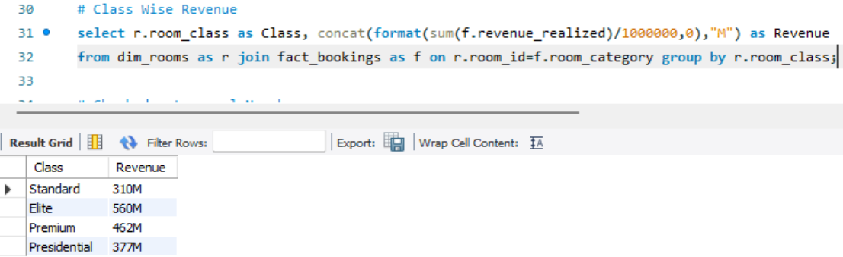
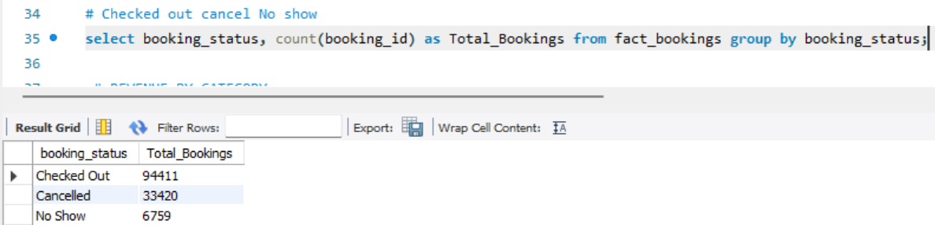

Slide 15

Core Observations

Slide 16
Mumbai generates the highest revenue, and room categories RT2 & RT3 contribute the largest share, showing where the business performs strongest.
Nearly 1 in 4 bookings gets cancelled, which is a major operational issue affecting occupancy, revenue stability, and forecasting accuracy.
Overall occupancy is below optimal levels, indicating scope for improvement through pricing strategies, promotions, and city-specific campaigns.
Properties like Atliq Grands (303.60M), Atliq Exotica (278.82M), and Atliq Blu (247.23M) generate the highest revenue, showing that mid-tier and premium properties are the top contributors across the chain.
Weekday bookings and revenue are considerably higher compared to weekends, indicating that the business is more driven by corporate or weekday travelers rather than leisure guests.
Total revenue peaks around Week 27 to Week 29 (140M+), then shows a consistent decline toward Week 32, suggesting seasonal patterns or reduced customer demand in later weeks.

Slide 17

Improvement Measures

Slide 18
Reduce cancellations through better policies and customer communication.
Boost weekend bookings with targeted offers and packages.
Improve occupancy using dynamic, city-wise pricing.
Increase direct bookings via loyalty rewards and website promotions.
Enhance guest experience to improve ratings and retention.

Slide 19

THANK YOU

